Slide 1
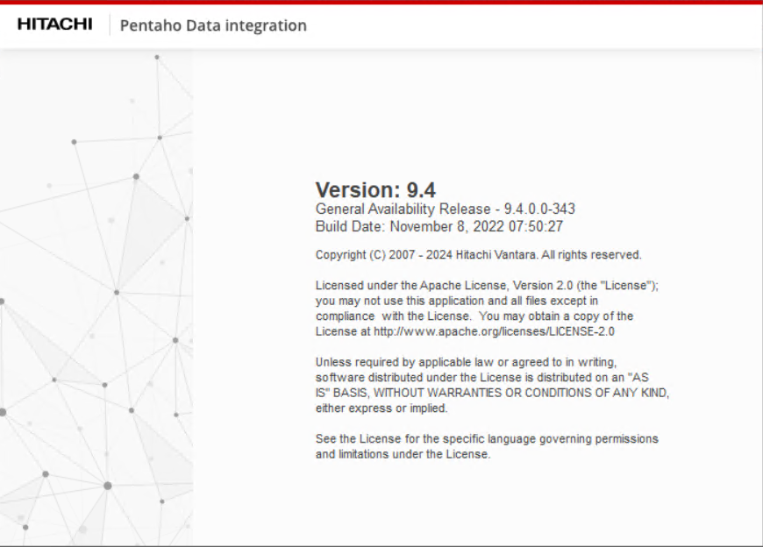
ETL
Pentaho Data Integration

Slide 2
History and ETL Projects
History
ETL Projects
The original data warehouse structure and ETL processes were created by 4Sight (a third-party vendor).
It appears that it was initially designed for a tiny insurance company and later adapted to be more generalized for any insurance company.
I did not receive any support or assistance from the vendor.
The basic solution was substantially enhanced and tailored to meet the specific requirements of CSE.
"SPInn" - Customized 4Sight data warehouse (DW) and ETL solution tailored to SPInn transactional system, with data staging from Microsoft SQL Server and later transitioned to AWS Aurora.
"SPInn Extra" - Custom DW tables and ETL process developed specifically for CSE, based on SPInn transactional system with data staging from AWS Aurora
"UU" - DW and ETL system developed based on text export files originating from InsurPAS (reinsurance).
“ICO" - DW and ETL system developed based on text export files originating from InsurPAS (reinsurance).
"MGA" - DW and ETL solution built upon SPInn transactional system, with data staging from AWS Aurora.

Slide 3
Issues
The original ETL process was developed for a tiny company. When I began working at CSE, the incremental daily load took an astonishing 17 hours to complete.
There were no conditions implemented to verify if the data in the source system were ready for processing. Consequently, in case of any issues during the daily cycle, the only approach was to intervene in the middle of the night to halt a scheduled process or restore from backups and restart the following day.
The original ETL was designed around a different insurance source system. Despite attempts to adjust staging queries, some crucial information was lost in the data warehouse.
The database structure and ETL processes were intended to be agnostic to any specific database platform. However, instead of utilizing SQL, T-SQL or PL/SQL stored procedures, JavaScript and Pentaho Spoon "lookups" were employed. This approach resulted in slow performance and excessive memory consumption. Notably, the AWS EC2 instance used for our ETL tasks was the largest in the company.
Numerous dimensions, metrics, columns, lookups, and JavaScript functions within the ETL were redundant and remained unused.
Conversely, essential attributes of the CSE business model were absent. Consequently, only basic financial metrics could be provided.
The existing implementation of SCD type 2 did not make sense. The information within these dimensions was static in CSE.

Slide 4
Enhancements and Adjustments
The first enhancement I implemented was a source system log check in a Pentaho Job to prevent false starts, along with a specialized schedule to verify source system readiness.
I conducted a comprehensive cleanup of the existing ETL process, removing unnecessary lookups, calculations, and other artifacts.
To boost ETL performance, I introduced parallel operations and implemented structural and database optimizations such as adding indexes and temporary tables.
As a result of these optimizations, the ETL process now completes in 2 hours, where 1 hour is dedicated to loading data into Redshift.
Unneeded SCD type 2 was removed and instead additional SCD2 dimensions were added in the structure. It allowed to build large number of data feeds and Tableau dashboards related to the quality of risk portfolio.
In addition to dimensional attributes, I incorporated new metrics derived from complex calculations performed across Aurora, Microsoft SQL Server, and Redshift.
I created 2 more, similar, but smaller, DW and ETLs for other companies' data sets based on text files.
Recognizing the limits of further improvement within Pentaho Data Integration, I developed a new ELT process using Redshift/Matillion. Data movement from Aurora to Redshift is facilitated by Fivetran.

Slide 5
ETL Steps
Set Variables
Test Database Connections
Set Load Date
Evaluate Start/No Start Automatic Load
Set Incremental Load date range
Load Staging from AWS Aurora
Load Dimensions in MS SQL
Load Policy Facts in MS SQL
Load Claim Facts in MS SQL
Export Data to Redshift
Update Log tables for automatic incremental load
Start Tableau dashboards refresh

Slide 6
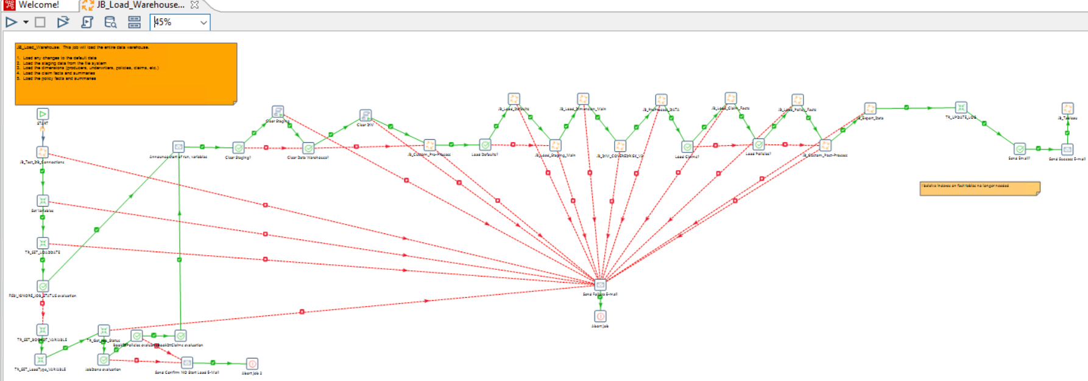
Load Warehouse Job

Slide 7
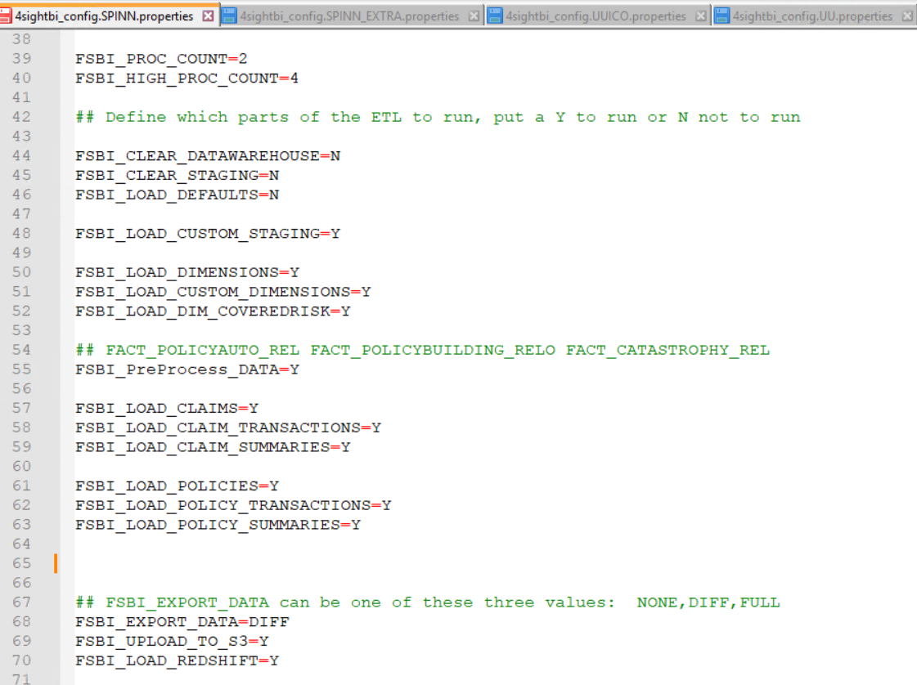
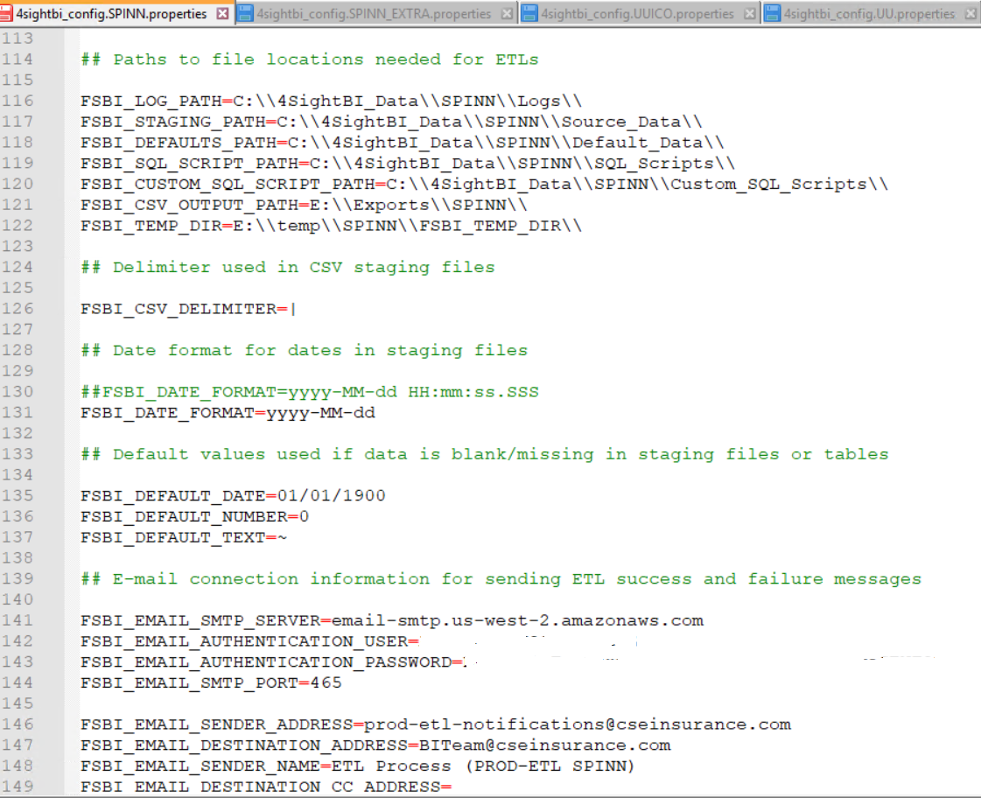
Fragments of Configuration File

Slide 8
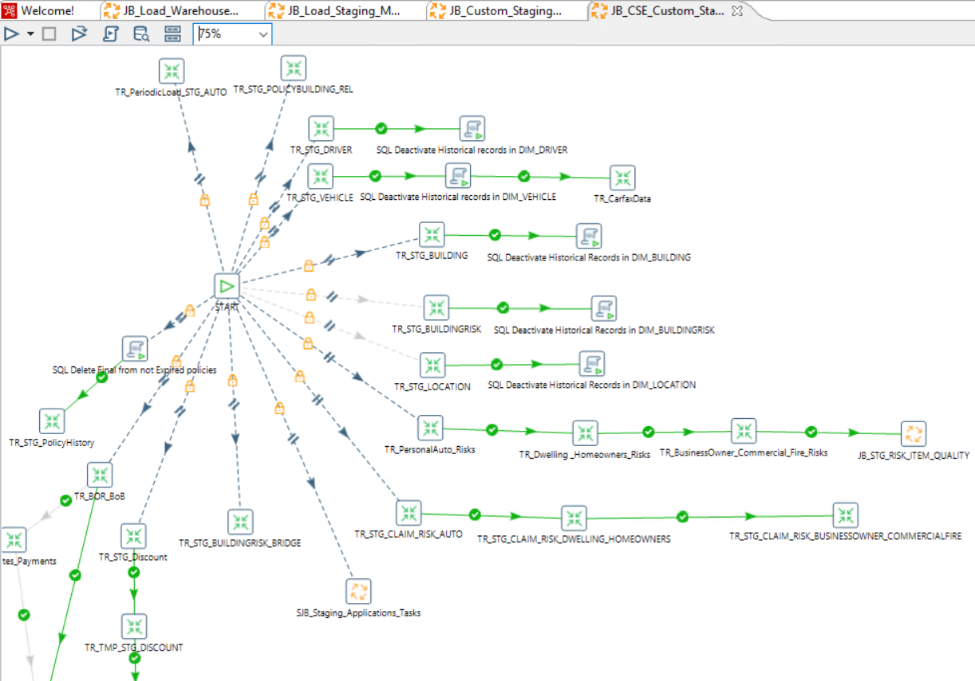
Load Staging

Slide 9
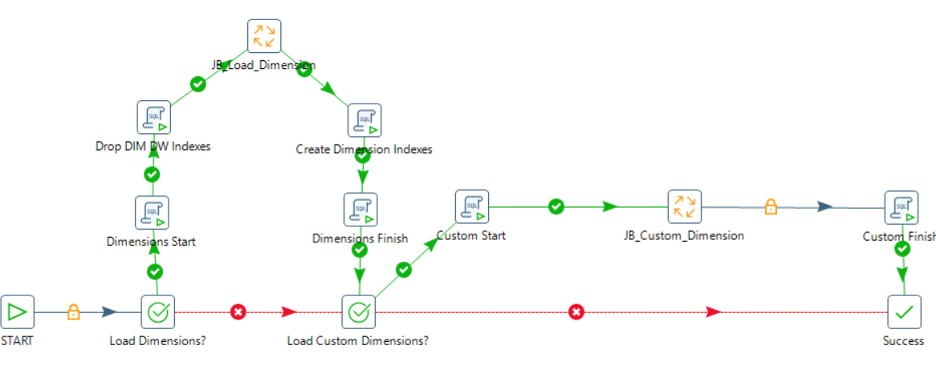
Load Dimensions

Slide 10
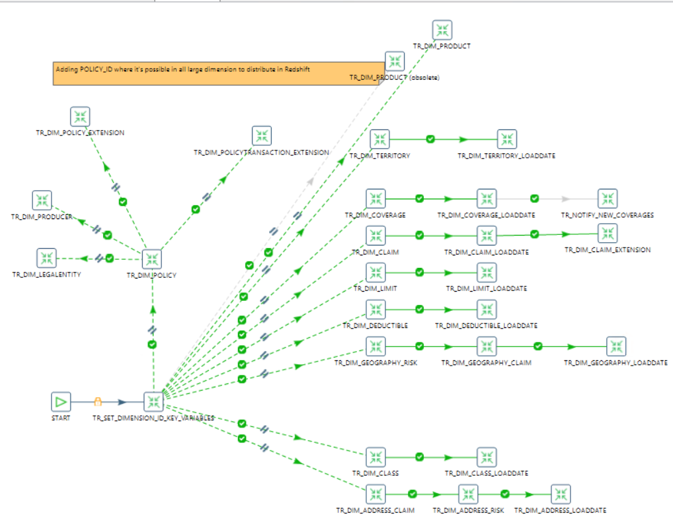
Load Dimensions

Slide 11
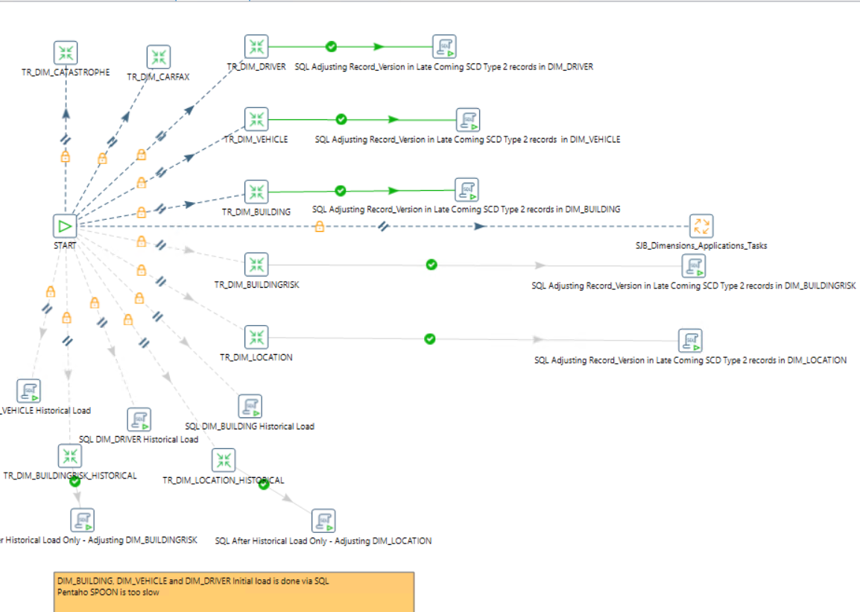
Load Dimensions

Slide 12
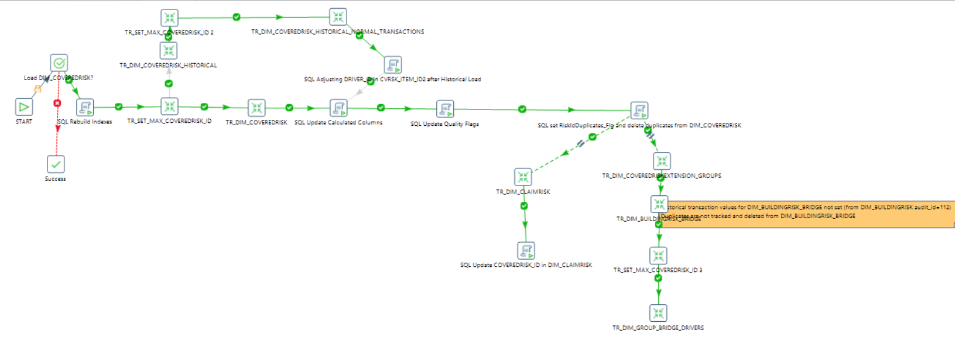
Load Risk related Dimensions

Slide 13
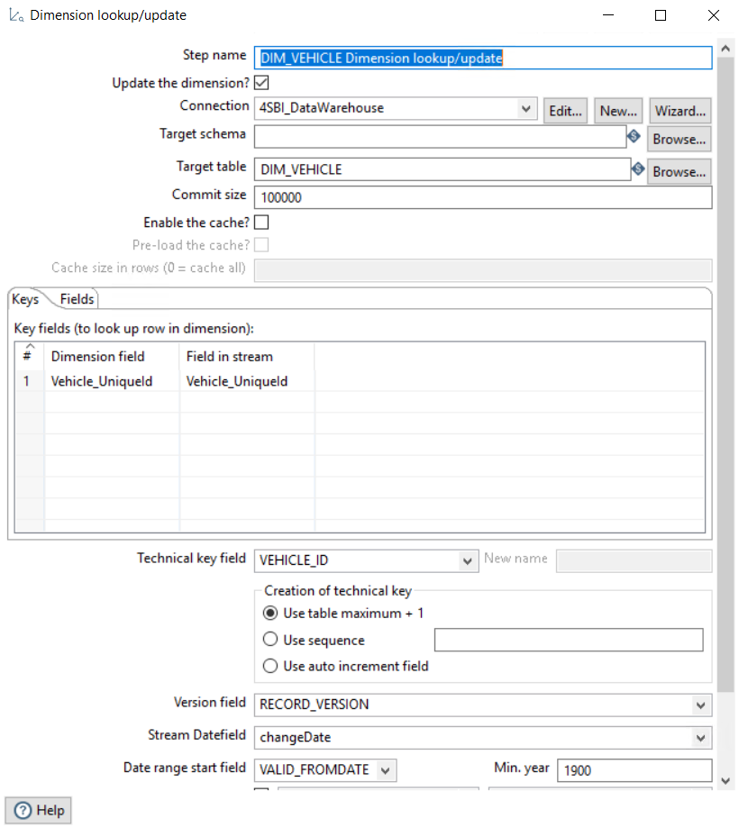
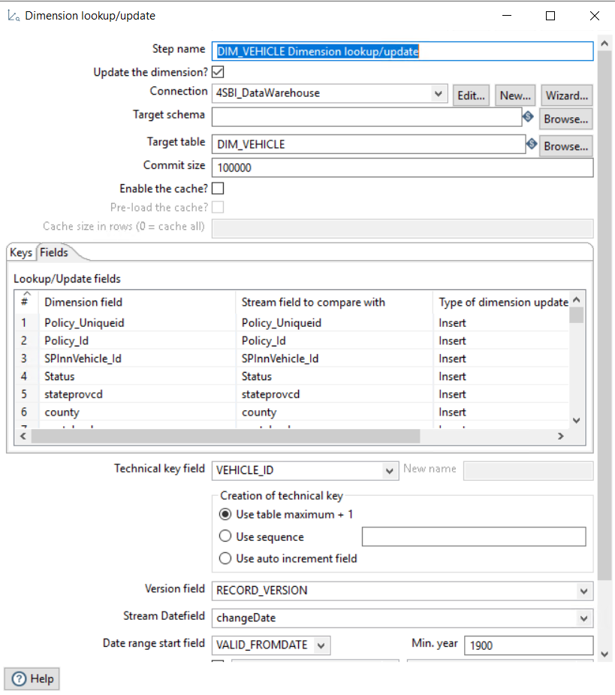
SCD Type 2 Dimension

Slide 14
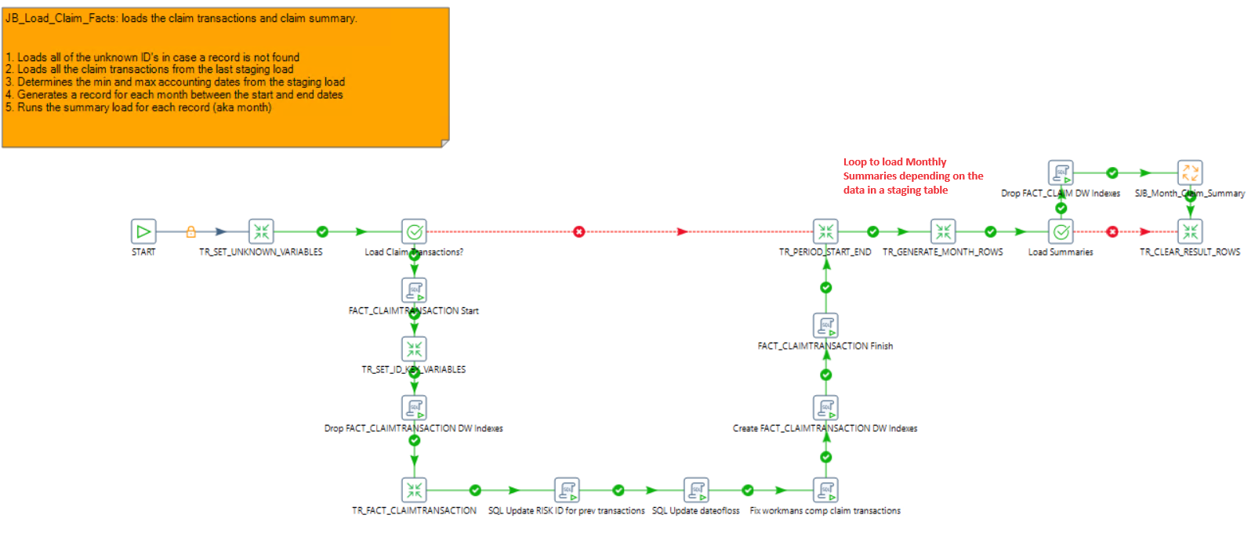
Load Claim Fact Tables

Slide 15
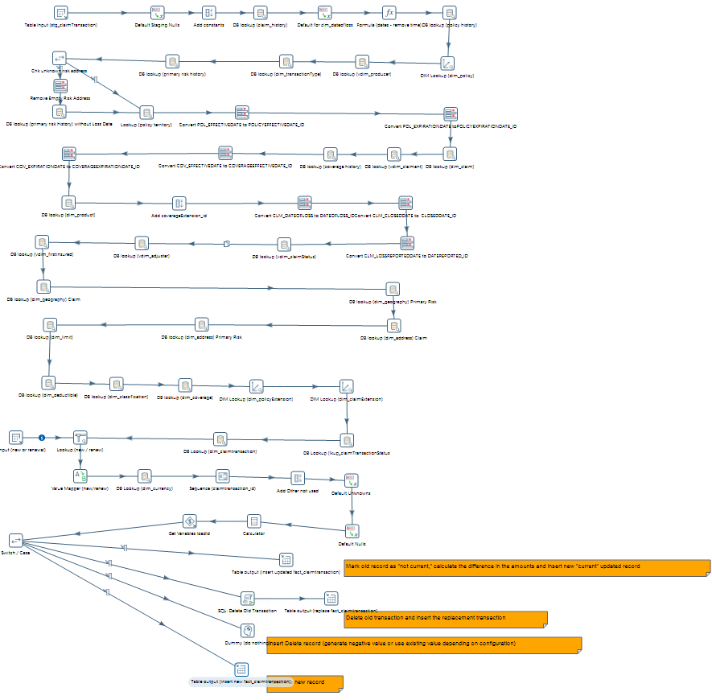
Load Claim Fact Transactions

Slide 16
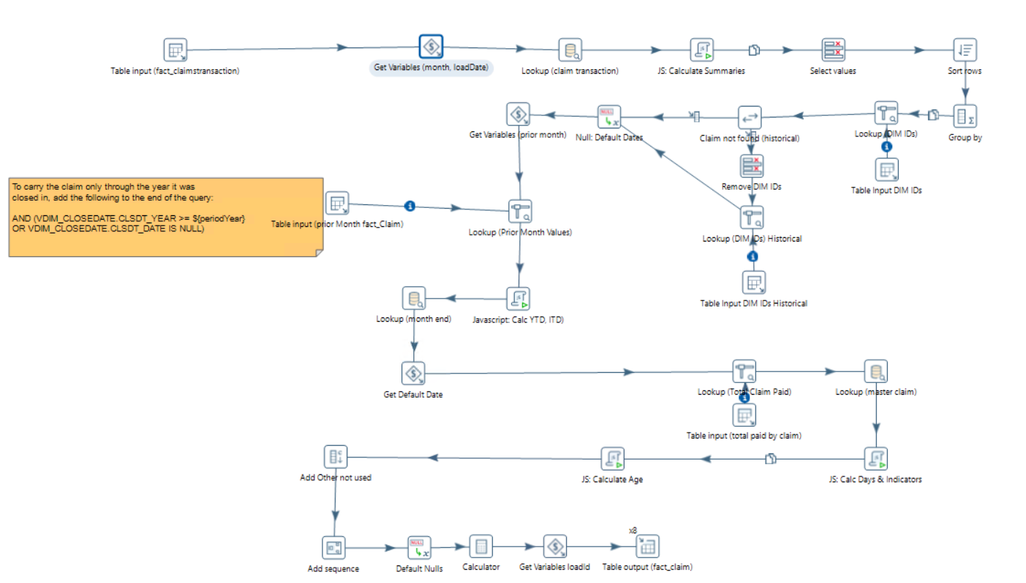
Load Claim Fact Monthly Summaries

Slide 17
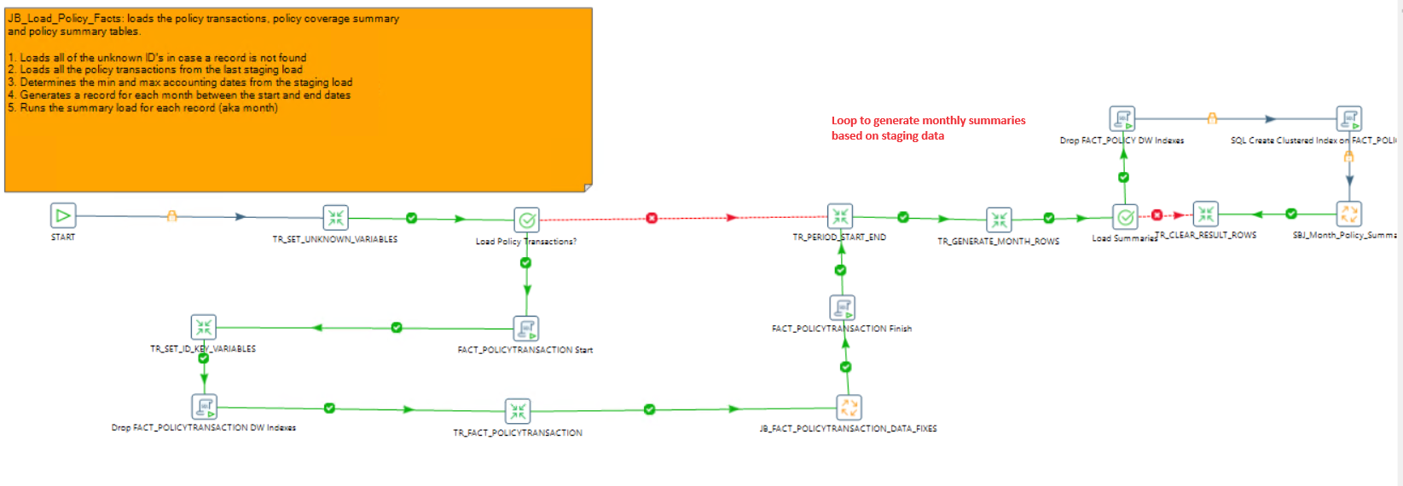
Load Policy Fact Tables

Slide 18
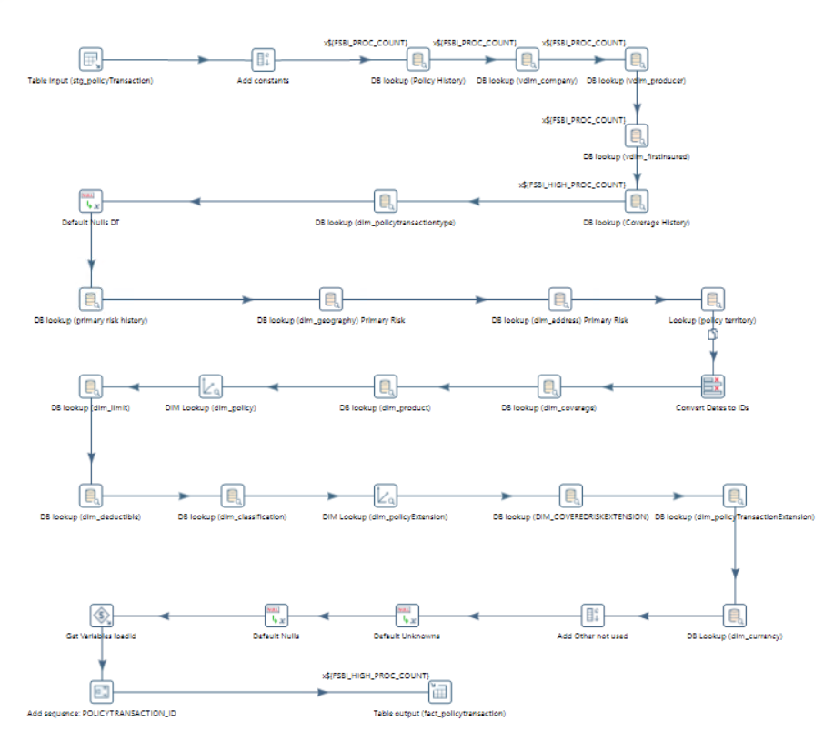
Load Fact Transactions

Slide 19
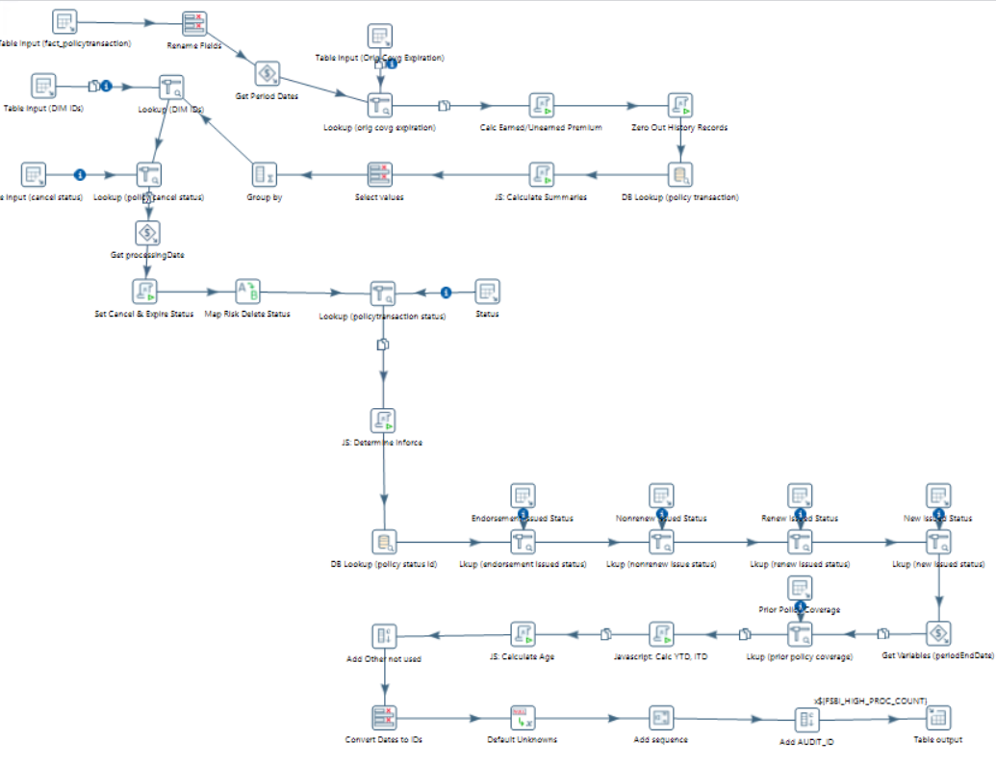
Load Policy Fact Monthly Summaries

Slide 20
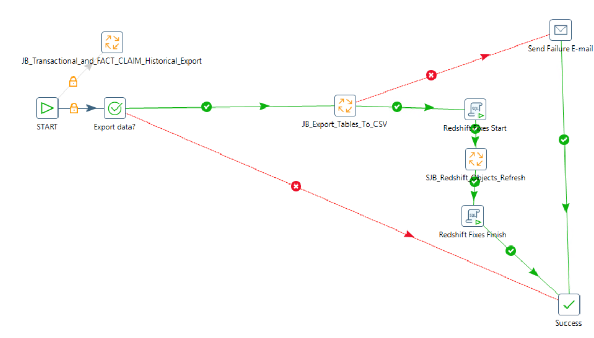
Export to CSV -> AWS S3 -> AWS Redshift

Slide 21
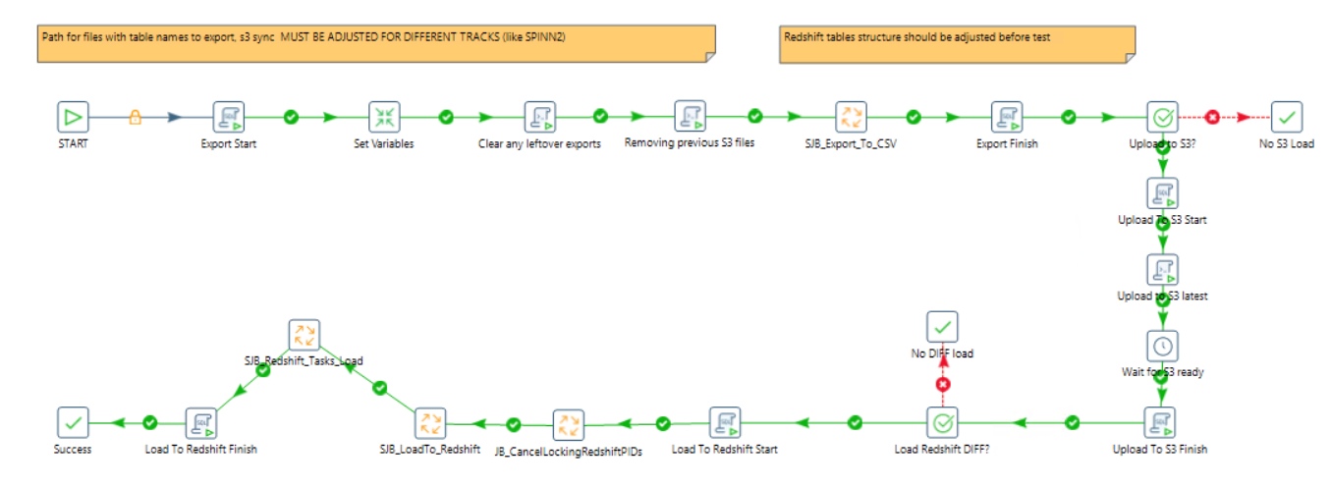
Export to CSV -> AWS S3 -> AWS Redshift

Slide 22
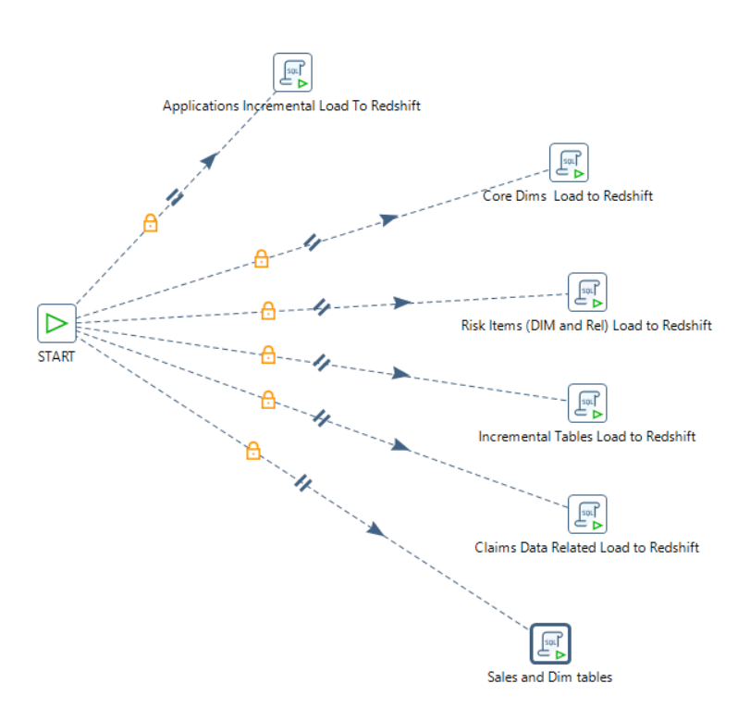
Export to CSV -> AWS S3 -> AWS Redshift

Slide 23
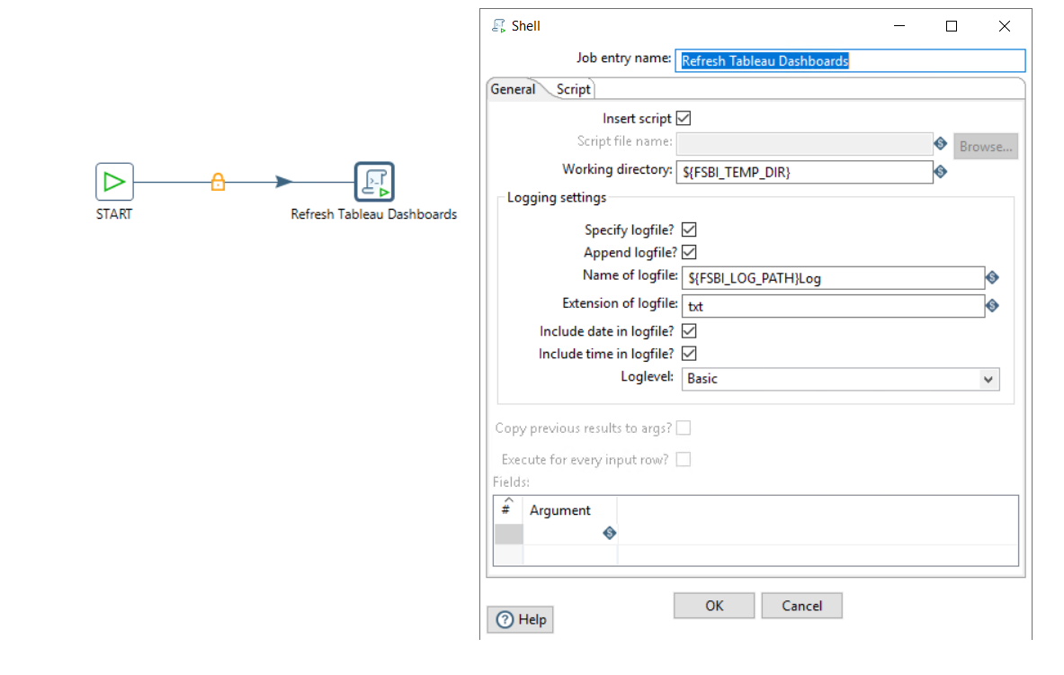
Start Tableau Dashboards Refresh

